Slide 1

Innovation
of
HARJINDER SINGH
CHEEMA
Cheema Boilers
and

Slide 2

Steaming Ahead
Distillery waste spent wash slop fired boiler.
Cheema Pump an energy-saving device.
Smart Park’s most economical car parking system.
Noble Cause human body disposal system can be used as a biological incinerator.
On-site generation of hydrogen for carbonless burning producing zero emission Boiler.
Cyclone separator for separation of gases.
Heat Pipe A device for the transfer of heat using liquid media.

Slide 3




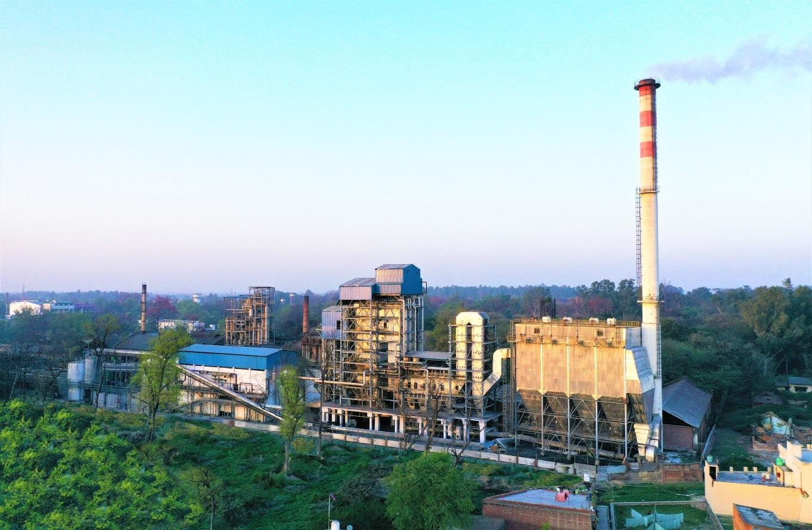
SLOP FIRED
Innovation 1
Spent Wash/
Boiler
From the Pioneers & Leaders in Slop/Spent Wash
Fired Technology
100 Days
Guaranteed Operation

Slide 4

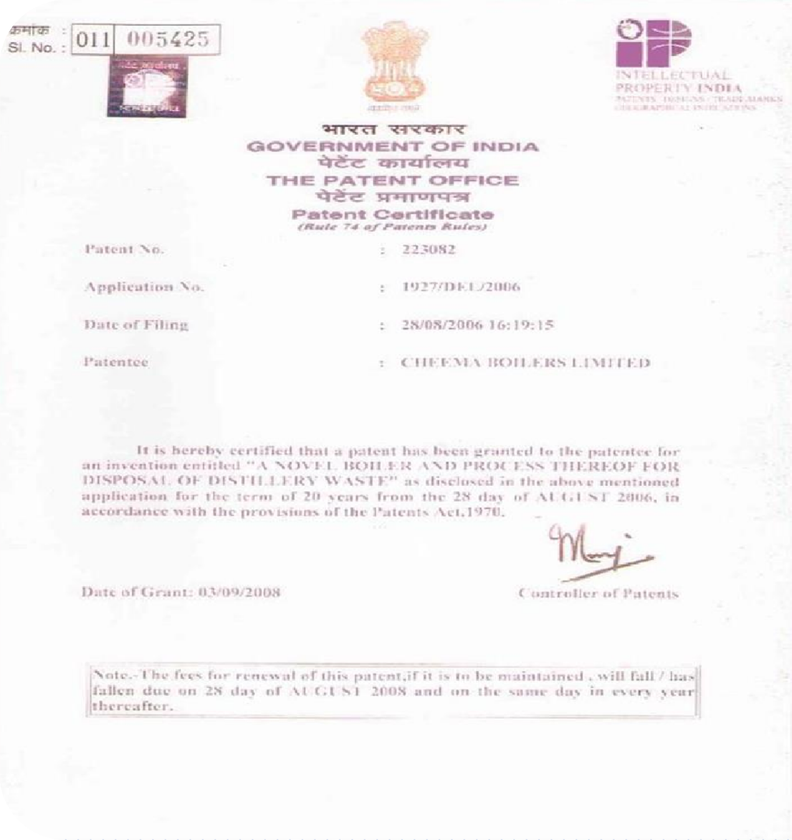




1
PATENTED DESIGN
since 2006

Slide 5

REQUIREMENT OF SLOP FIRED BOILER
1
1.
To comply with the statutory norms to control pollution and to save groundwater.
2.
The effluent from the distillery is taken to a concentrating unit called an evaporator and concentrated to 55 to 60% solids, either by RO or by evaporation system, and then fired into a specially designed incineration boiler along with minimum support fuel like coal, rice husk, bagasse.
3.
The concept is called
ZERO LIQUID DISCHARGE

Slide 6
THE INCINERATION BOILER
1
This consists of a specially designed boiler where the concentrated slop is sprayed from a height into the furnace in such a way that the slop gets atomized dried and burns effectively in the large volumetric furnace.
The slop is sprayed at a height so that it should not fall on the grate and should not carry away to 2nd pass.
The boiler has special features to handle the high Potash present in slop. Boiler should handle moisture up to 55 % i.e. 45 % solid only
The Superheater is designed to avoid corrosion due to alkalis and to avoid soot formation due to ash properties.
Online cleaning arrangements for the smooth running of the boiler.

Slide 7
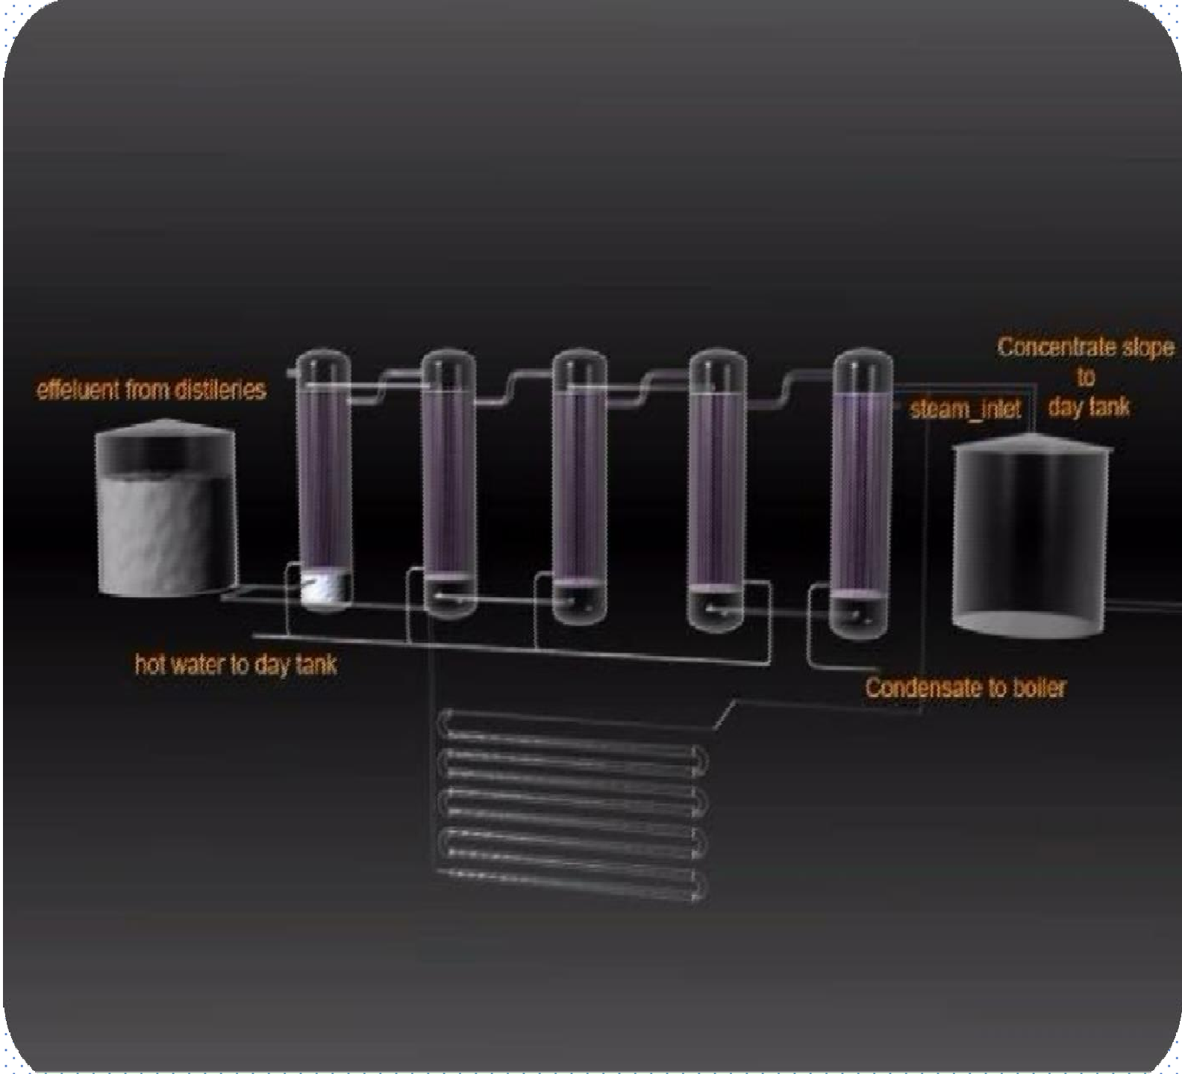

The Evaporation Process
1

Slide 8
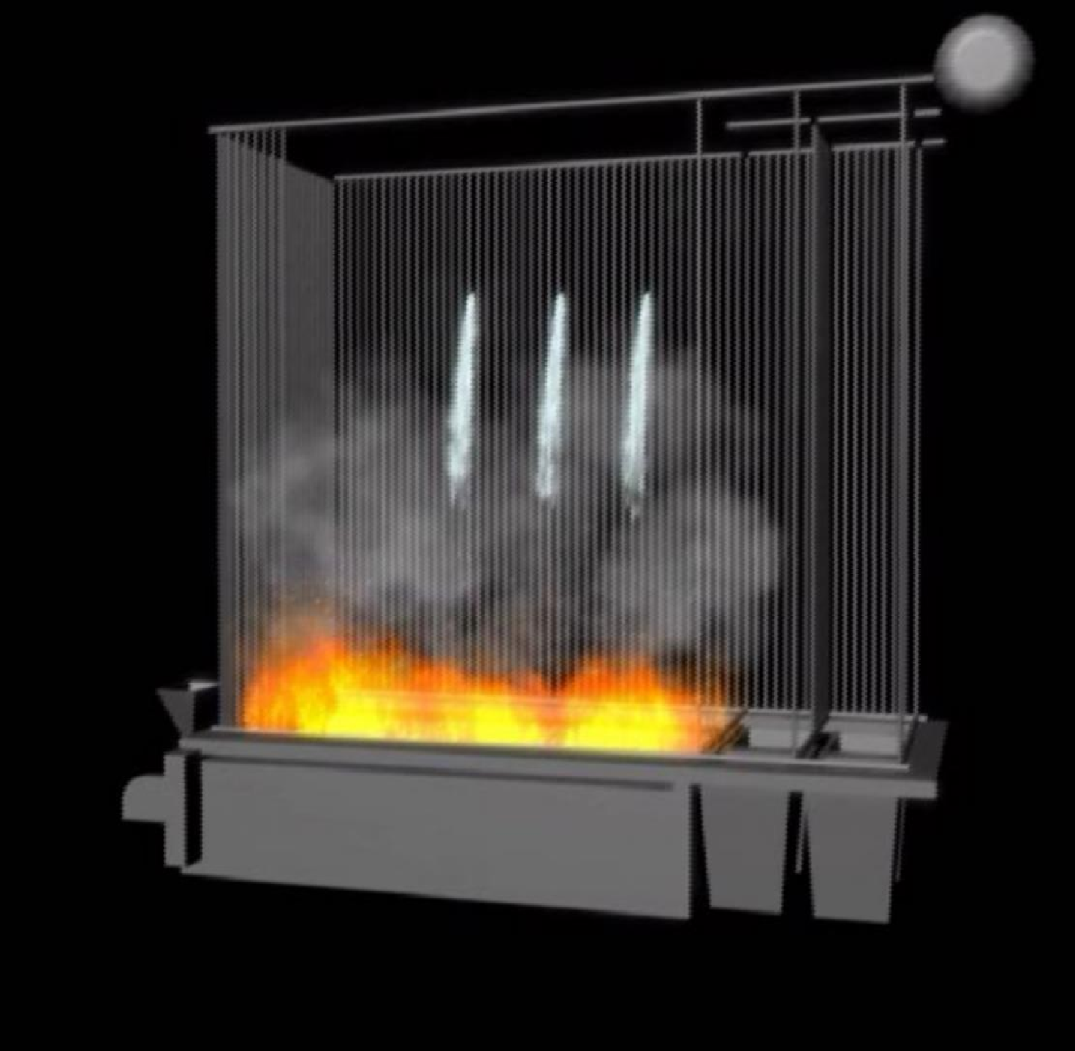

SLOP FIRING SYSTEM
1

Slide 9
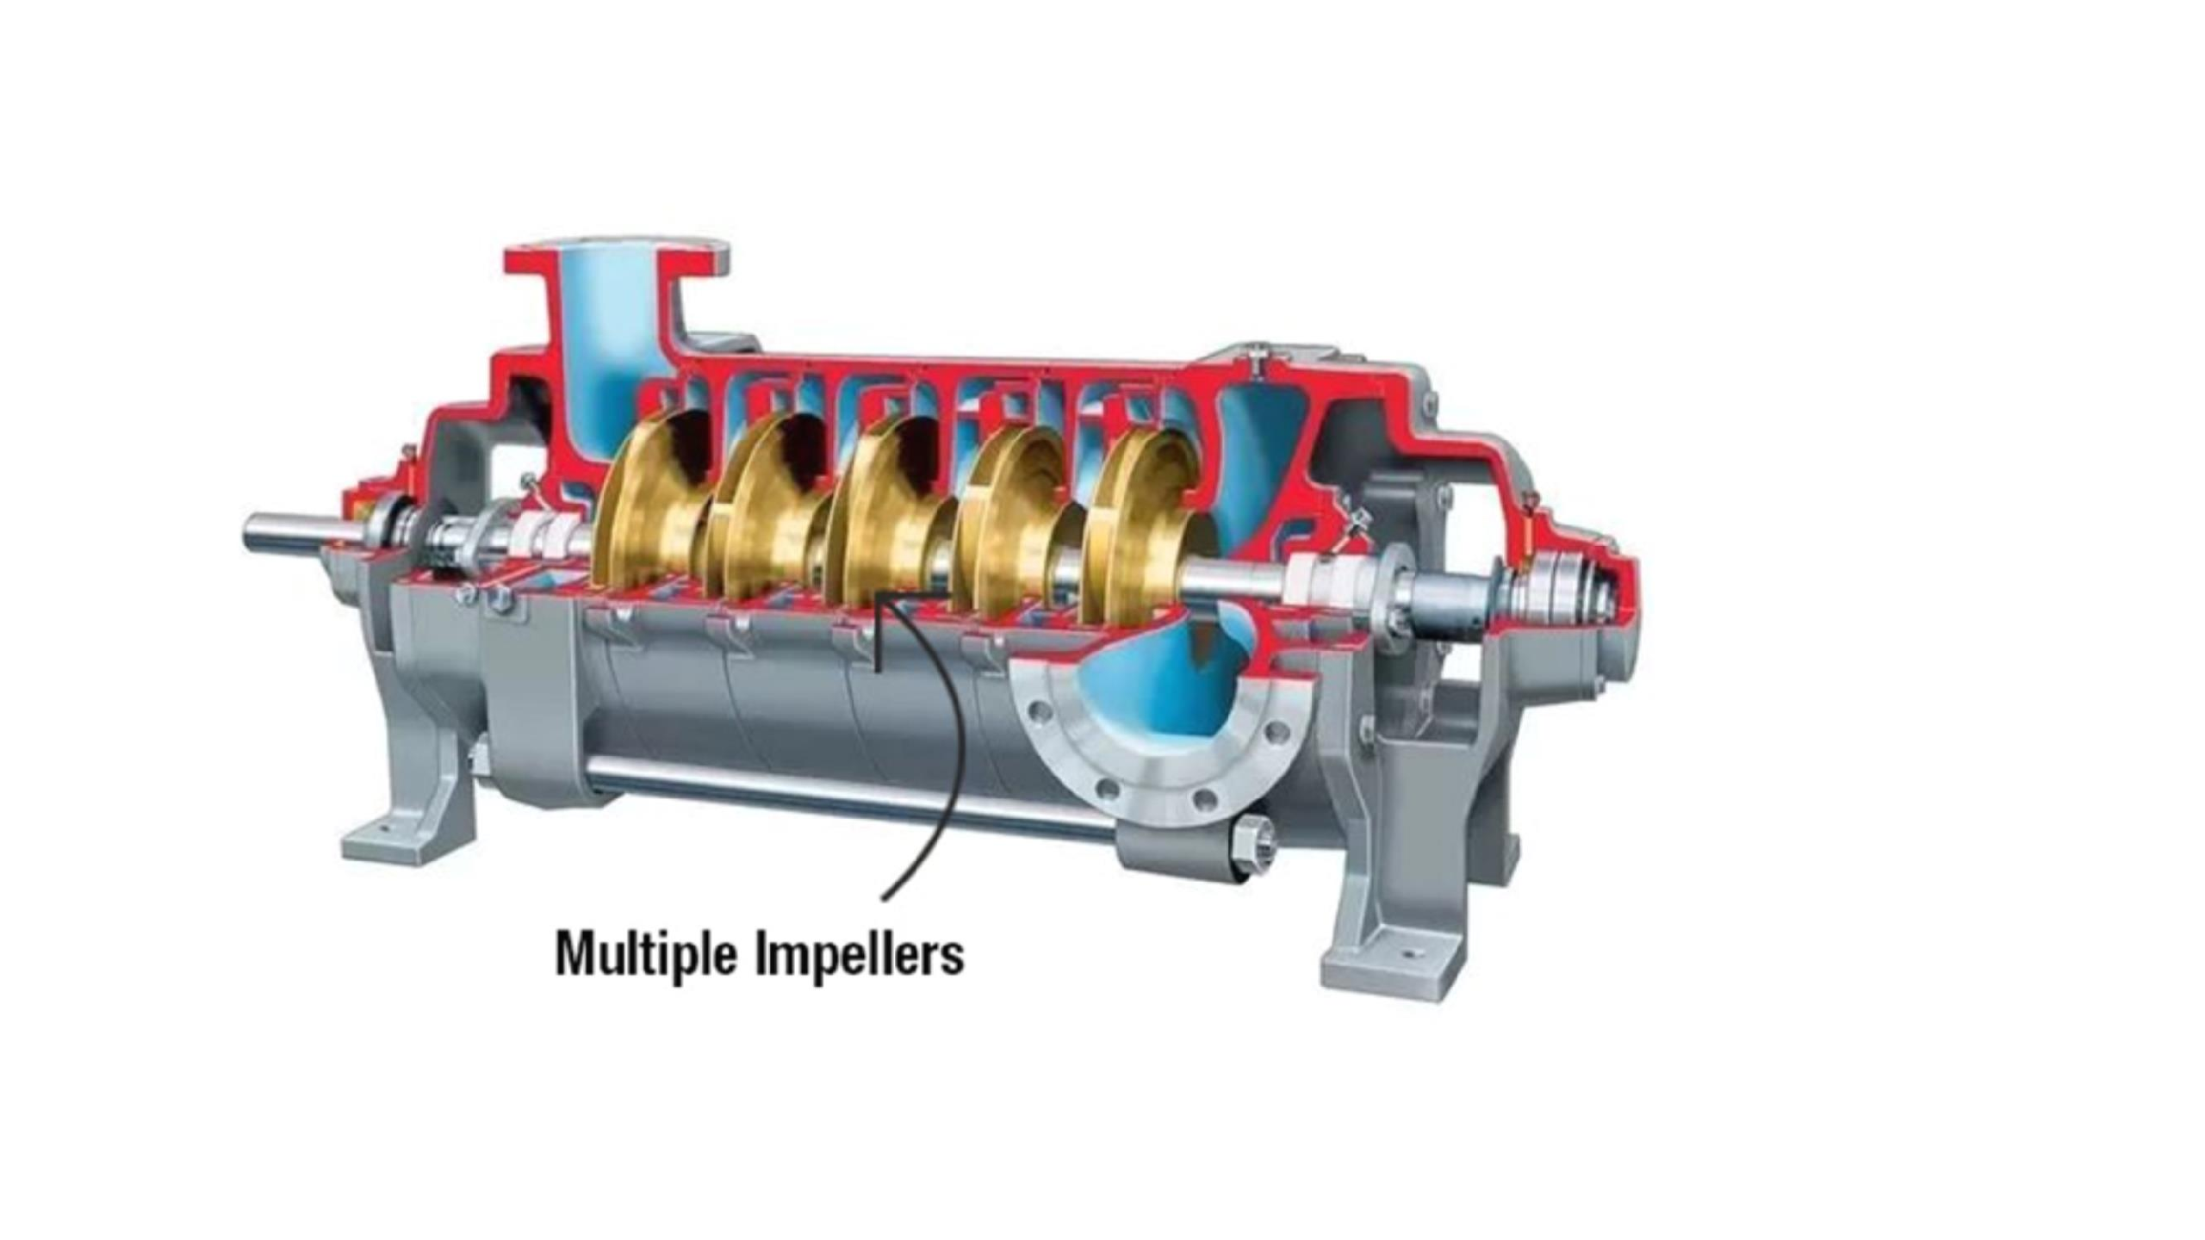






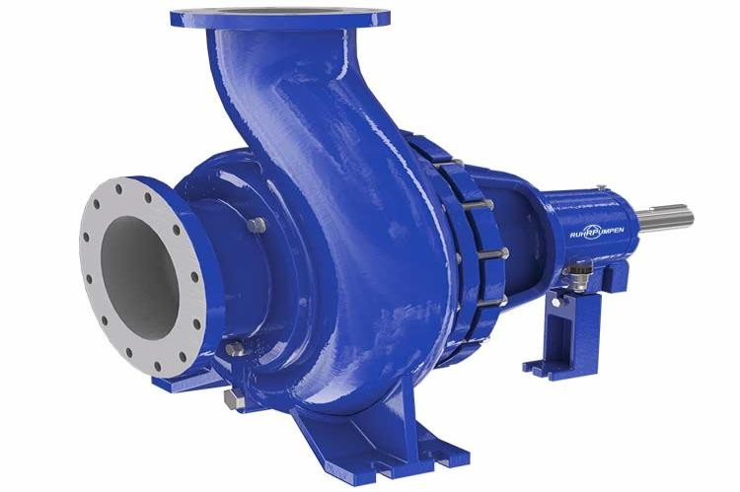
Innovation 2
20 HP
2 HP
REPLACED

Slide 10
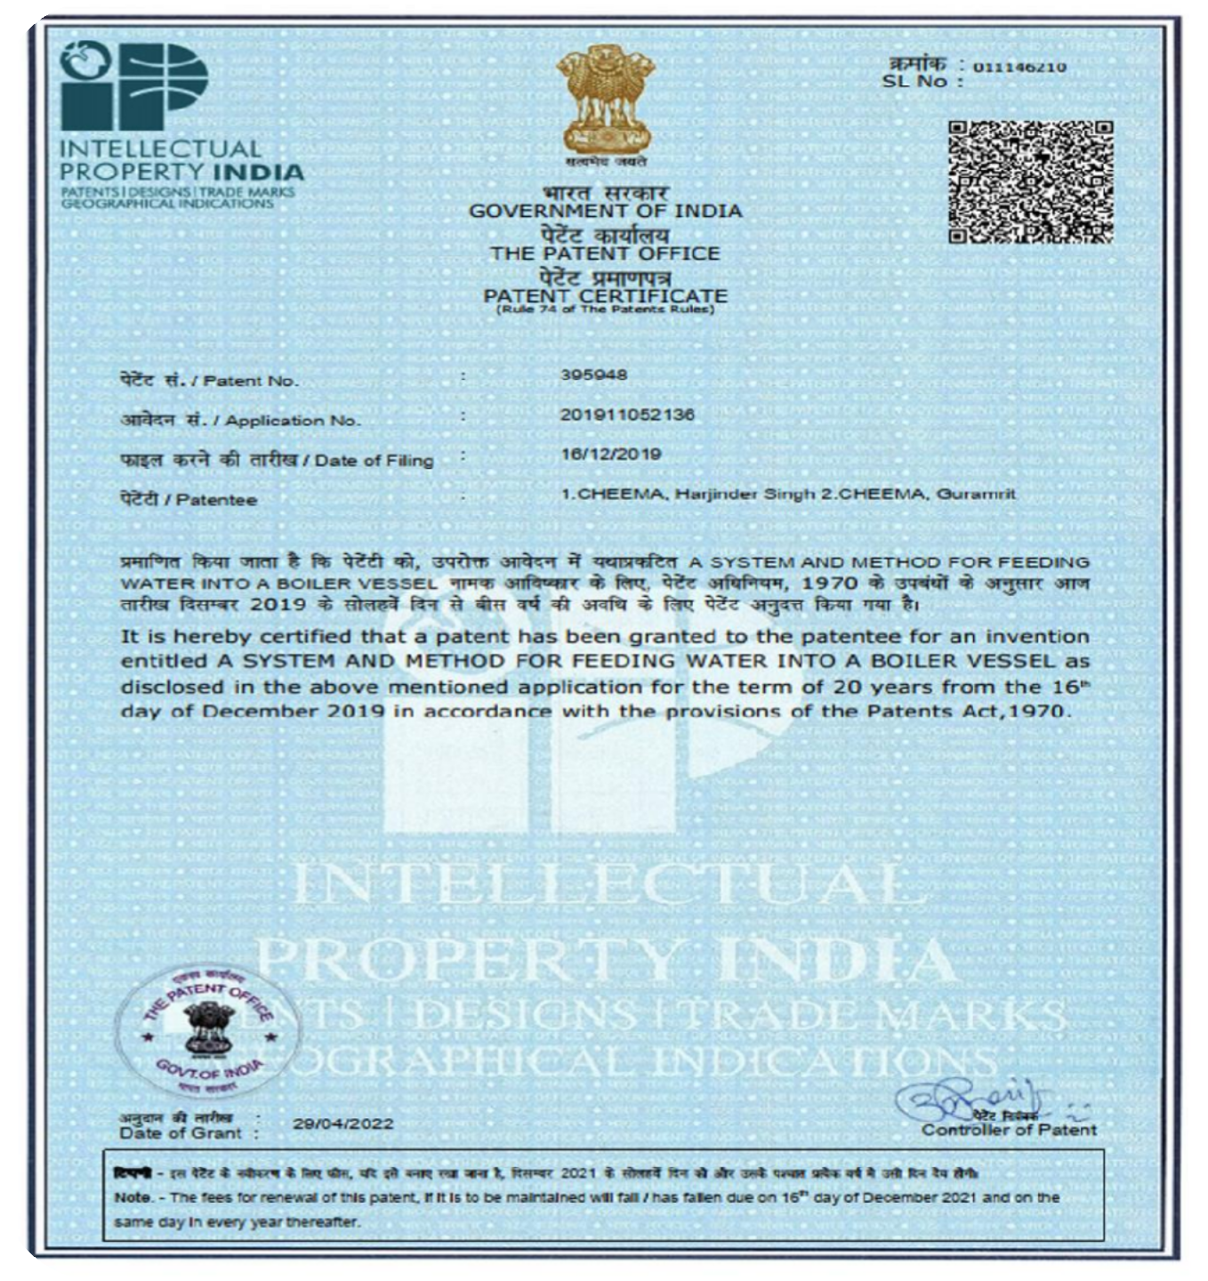

PATENTED
2

Slide 11
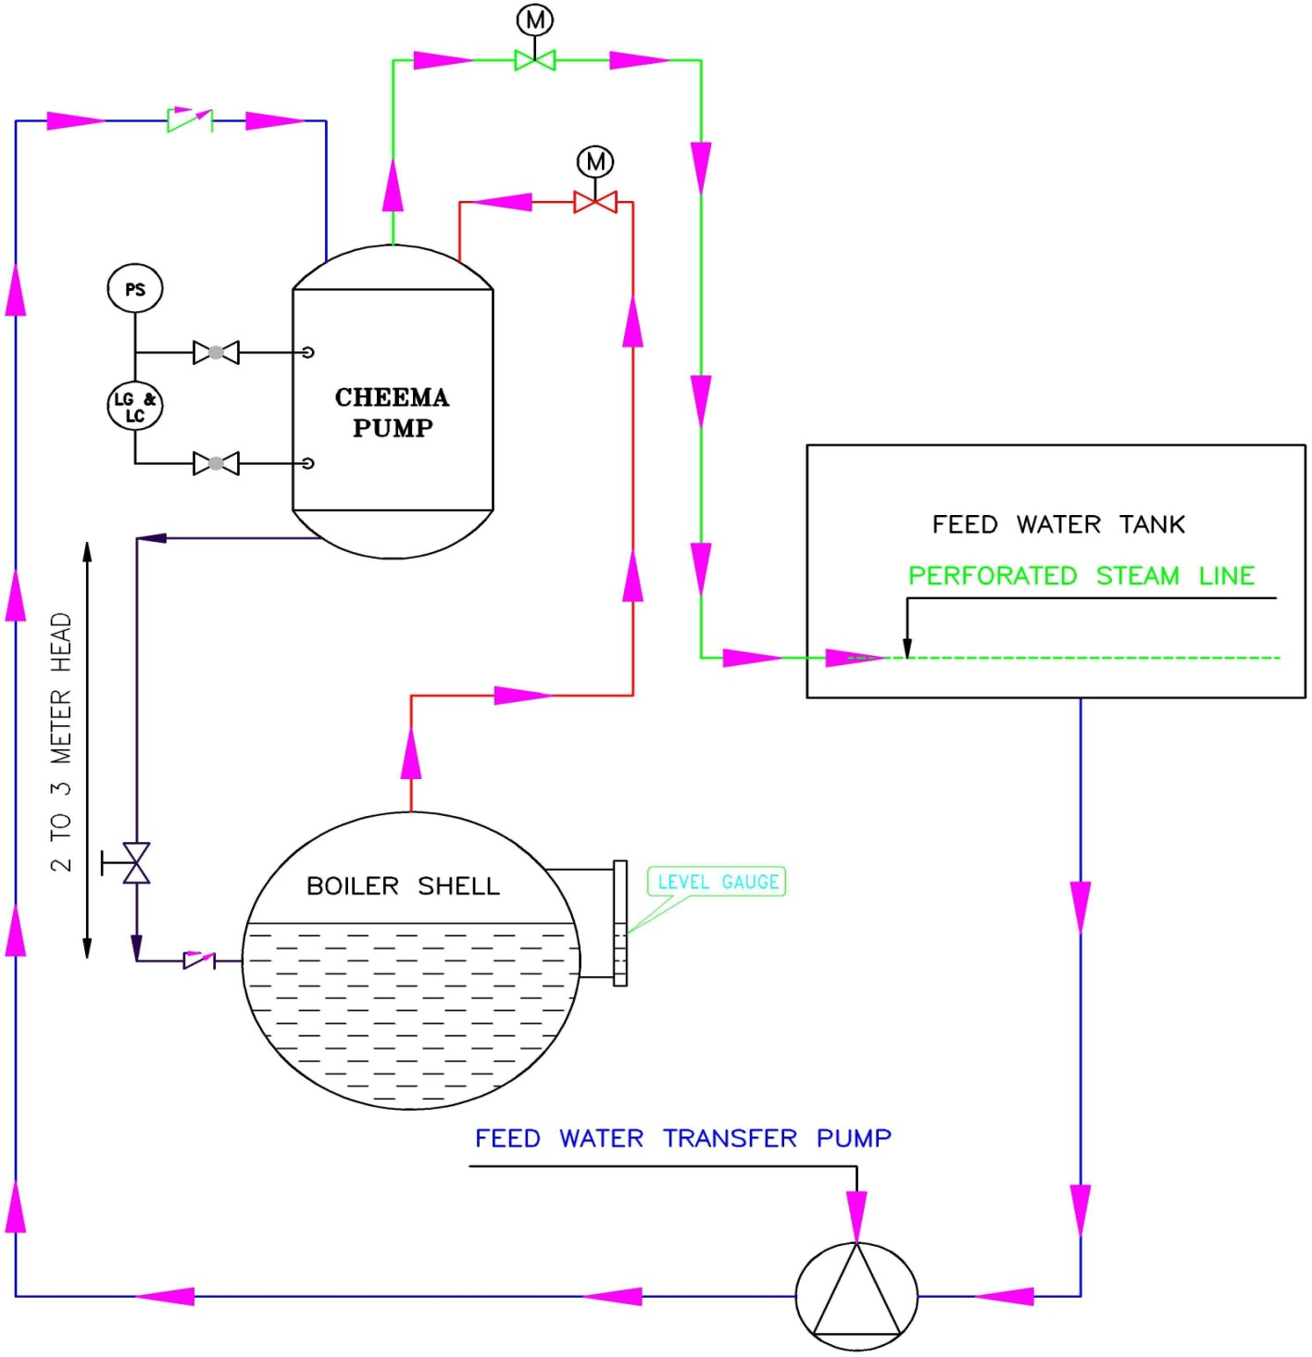
The Working
Principle
2
Cheema Pump
The basic principle used here is to feed the water into the boiler by using the force of gravity. Thermal energy is used to facilitate the process of gravity.
This has high pay back period less then a year.

Slide 12
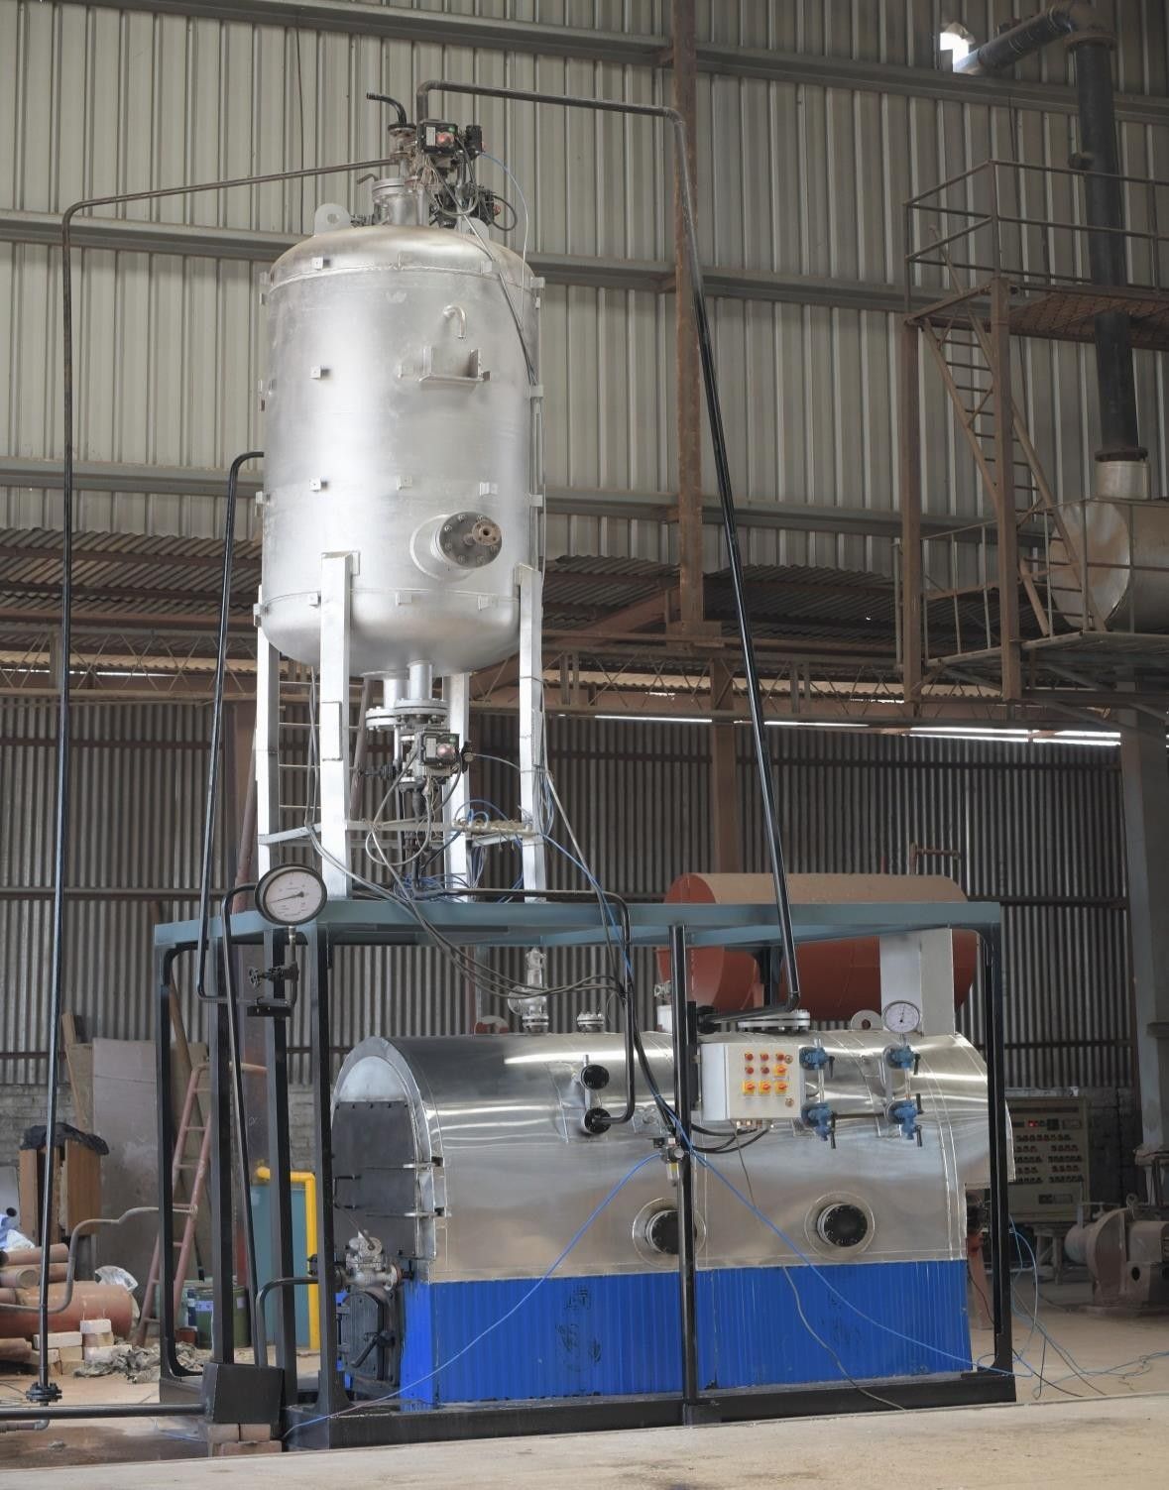
The Advantages
This Pumping device has the following advantages over the existing multistage boiler feed water pumps.
2
Minimum energy consumption.
Low maintenance as there is no moving part
involved.
It can work on any working pressure of the boiler.
CHEEMA PUMP

Slide 13

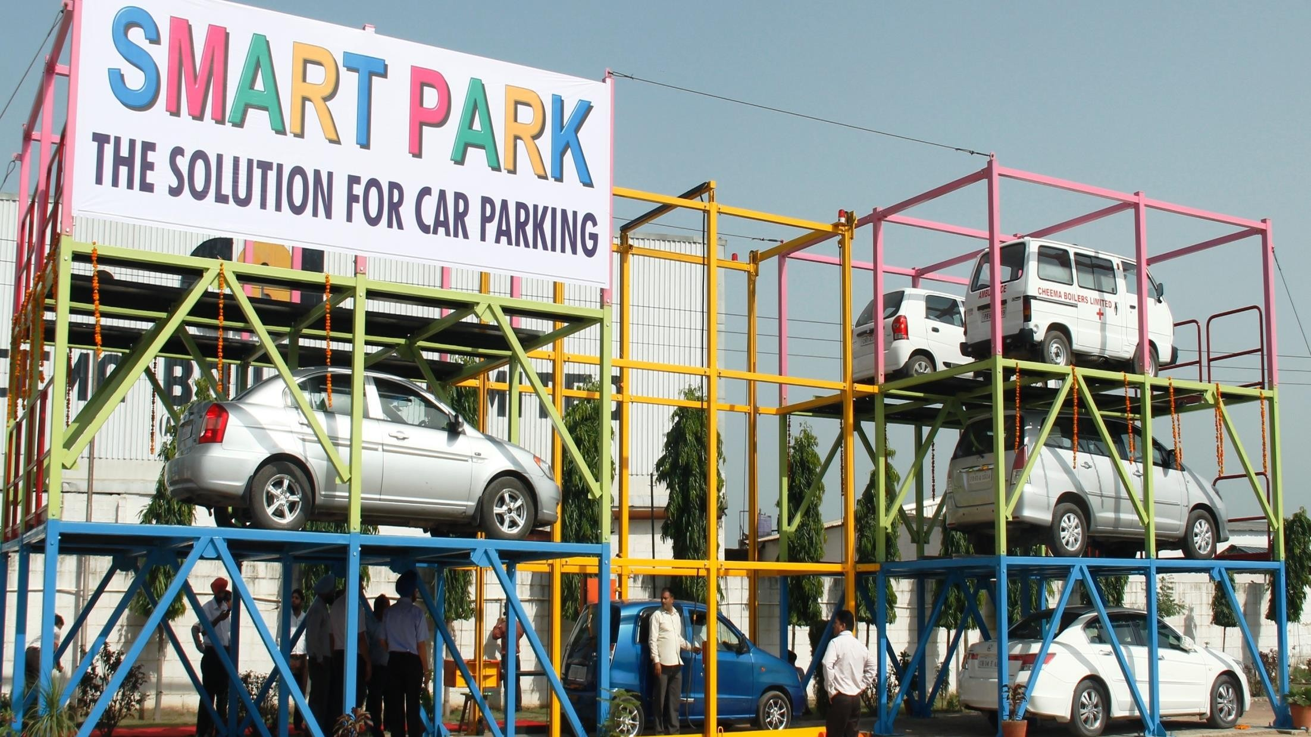
Innovation 3
SMART PARK The Solution For Car Parking

Slide 14

SMART PARK
3
This parking system is very economical initial cost, almost negligible maintenance and operation cost.
In order to save the power consumption and cost, it has been designed to use the inbuilt
propulsion arrangement of the car to shift it from one place to another within the parking system.
The entire operation is done by a normal car driver and thereby eliminating the requirement of highly paid computer operator being used in other such parking systems.
This system is suitable for installation in a basement/ terrace or other confined/small parking spaces within any building. It can be housed in green area of the apartments also.

Slide 15
SMART PARK
3
The system is designed on the multiple rack storage principle, thus it can house up to four times more cars than a conventional parking place. Thereby saving huge amounts of land cost and construction of Basement parking.
Being a portable system, it can be shifted from one place to another place without any loss of material and without much effort.
This system is supplied in a ready to install condition and is operational within 2-3 days time at any site.
The system can also be operated using diesel engine without usage of electric power (site locations, trade
fairs etc.) wherein the electrical power is not available or is in short supply.
Valet parking option – Since operator is already available to park and deliver the car, it has a facility of valet parking as the owner can leave the car at a single point for loading and delivery.

Slide 16

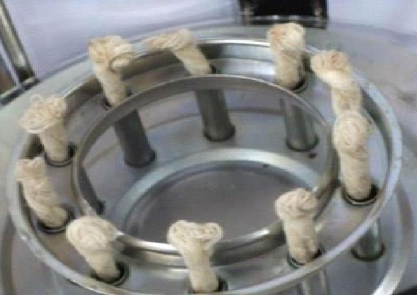
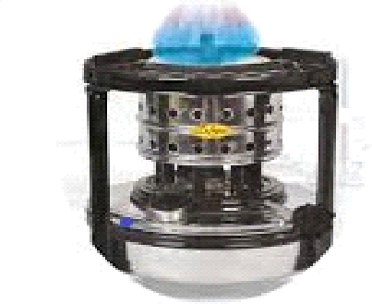
Innovation 4
A Noble Cause Scientific Way Of Human Body Disposal
The principle of this system is derived from a wick-stove wherein, the wicks when lighted glows yellow and this is converted to smokeless blue flame after installing the
combustion air system over these wicks.

Slide 17

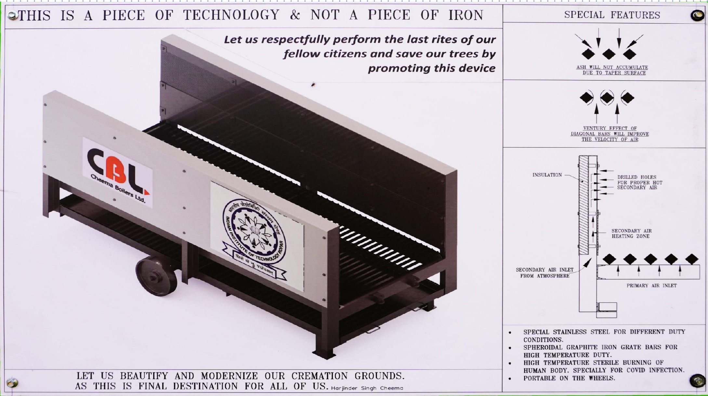
4

Slide 18

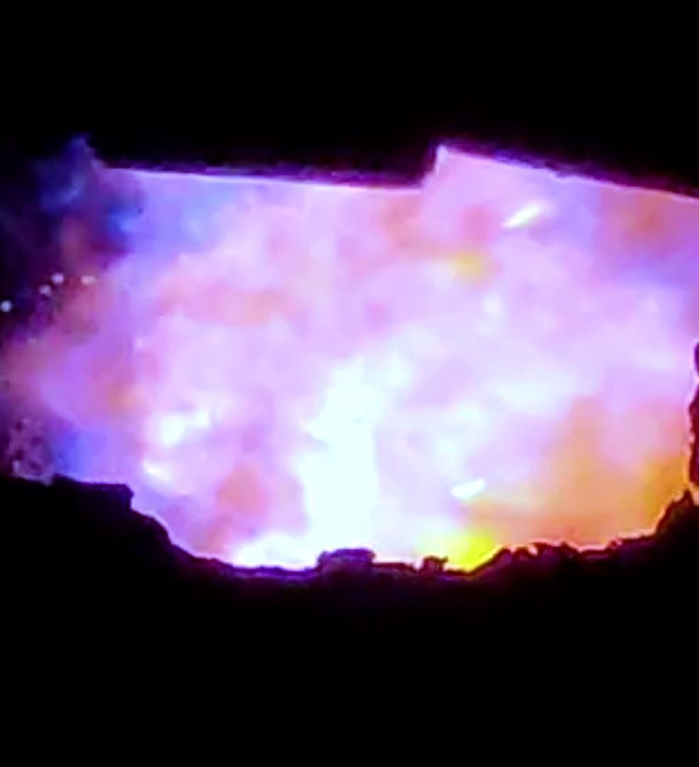



Innovation 5
ZERO EMISSION BOILERS
CARBONLESS HYDROGEN BURNING

Slide 19
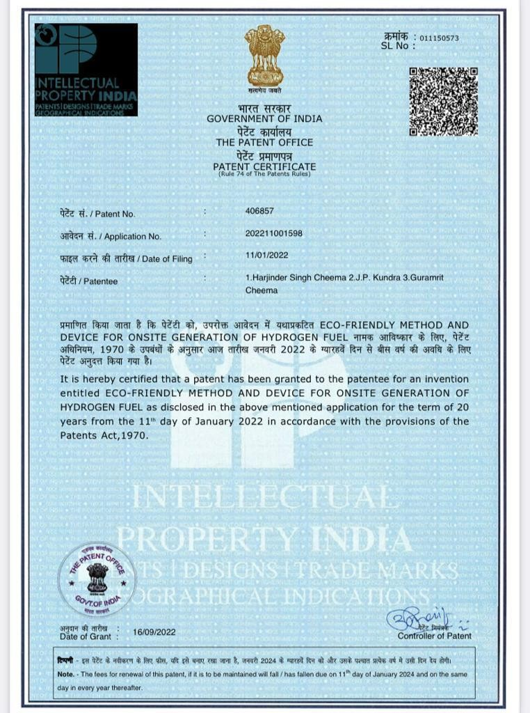

5
ECO-FRIENDLY METHOD AND DEVICE FOR ONSITE GENERATION OF HYDROGEN FUEL TO MAKE CARBONLESS BURNING

Slide 20
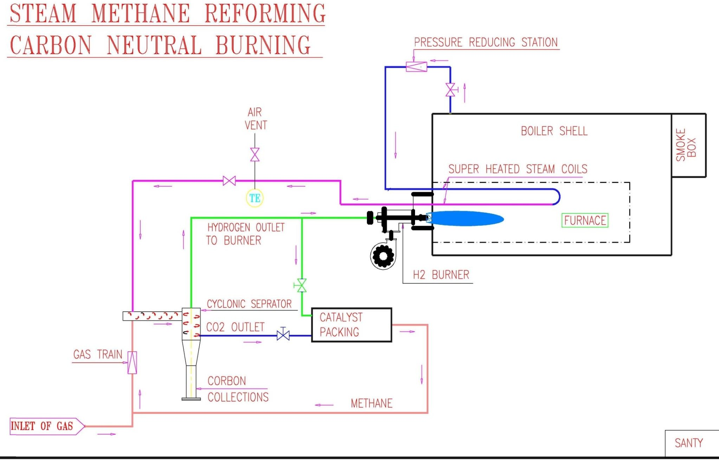
STEAM METHANE REFORMING CARBON NEUTRAL BURNING
5

Slide 21


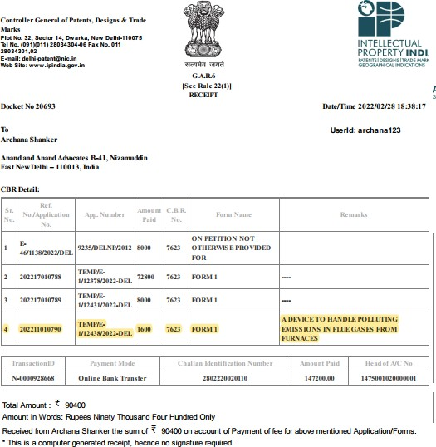

Innovation 6
CYCLONE
SEPARATOR
THE PRINCIPLE
As we separate cream from milk by a centrifuge separation same principle is used for the separation of gases with different densities by using this patented device.
PATENT PENDING

Slide 22








6
3.4 kg /NM³
2.62 kg/ NM³
2 kg /NM³
DENSITIS OF VARIOUS GASES
1.83 kg /NM³
1.16 kg/ NM³
1.25 kg/ NM³
NO2 Nitrogen Dioxide
0.64 kg / NM³
SO2 Sulphur Dioxide
CO2 Carbon Dioxide
Particulate Matters
Air at Ambient
Ch 4 Methane
Nitrogen

Slide 23
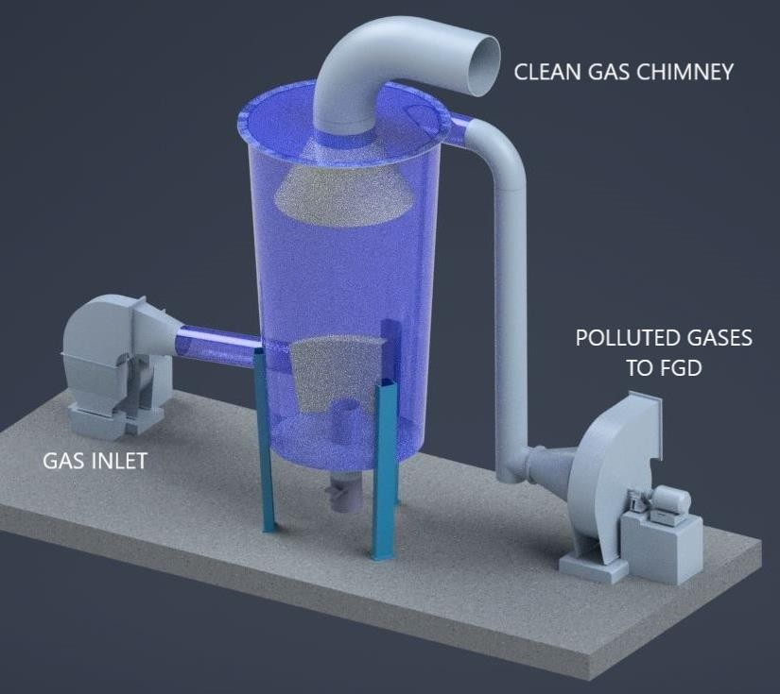
6
CYCLONE WITH TWIN OUTLETS FOR FILTRATION OF
GASES

Slide 24
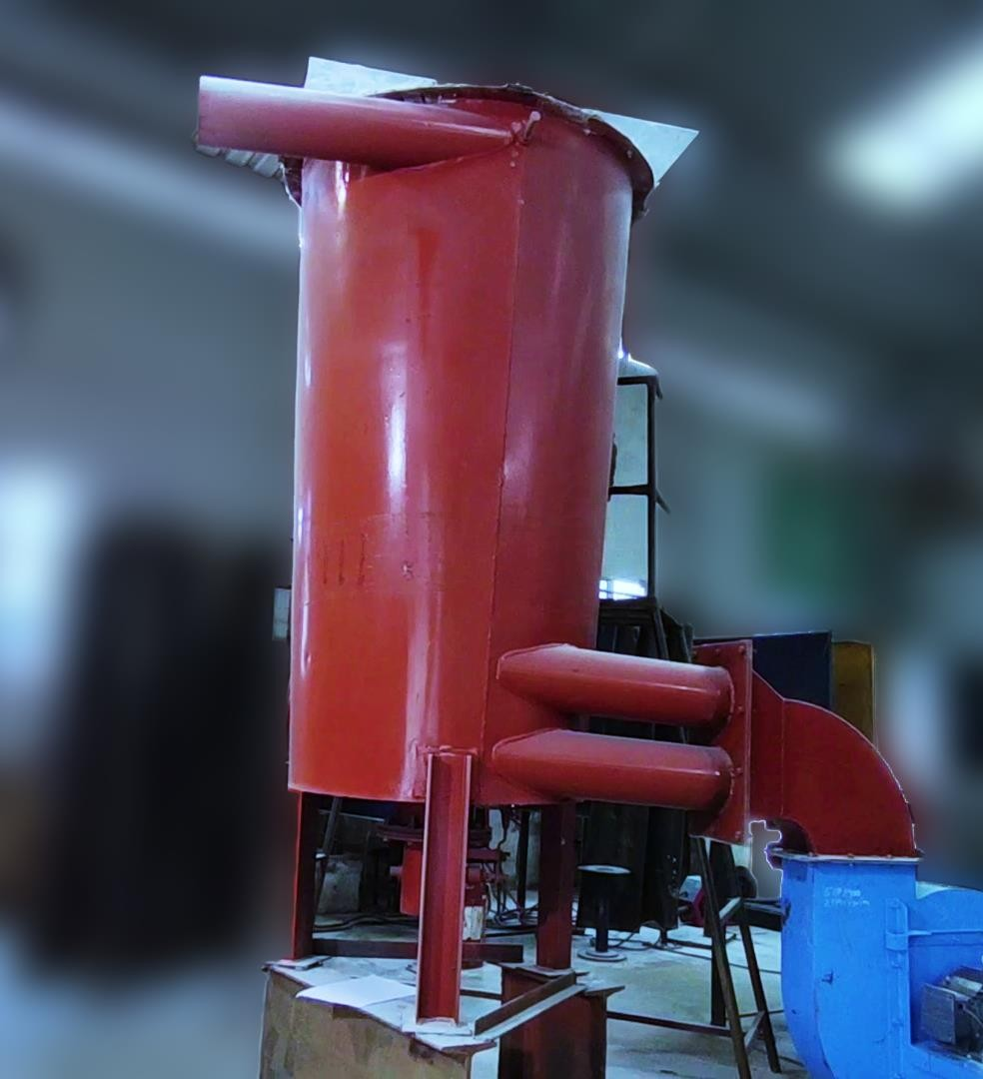
6
CYCLONE WITH TWIN OUTLETS FOR FILTRATION OF
GASES

Slide 25
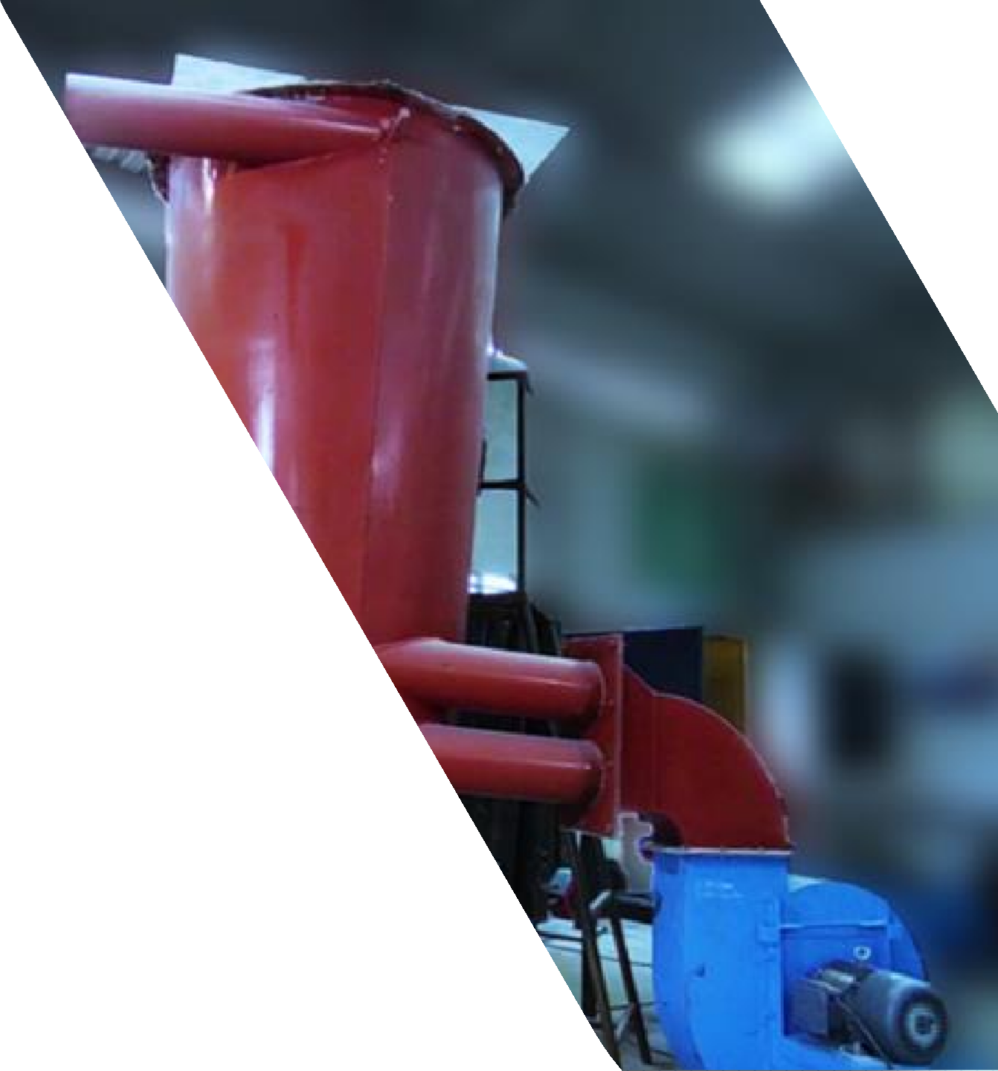
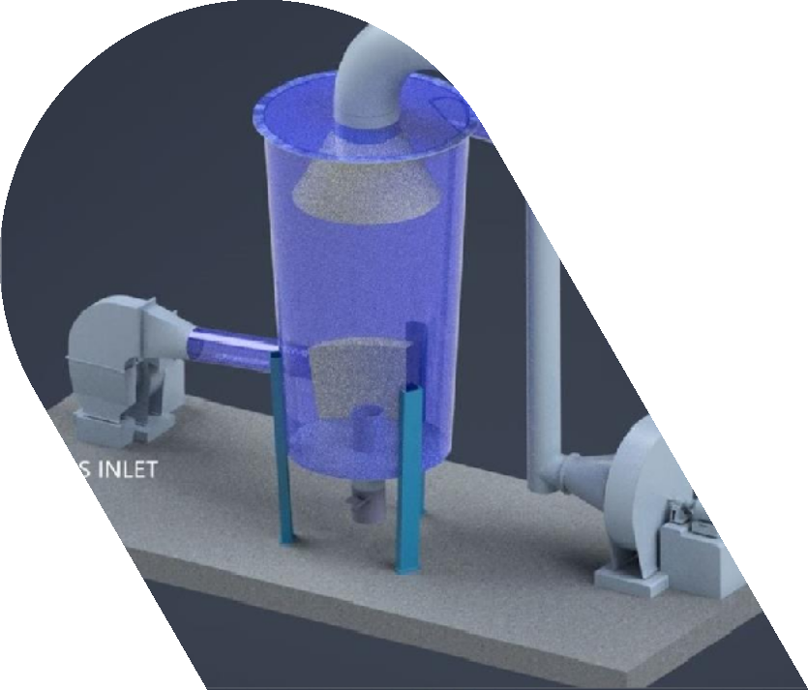
BENEFIT OF TECHNOLOGY
6
This system can drastically reduced the size of air pollution control equipment's as the high density gases can be treated separately.

Slide 26

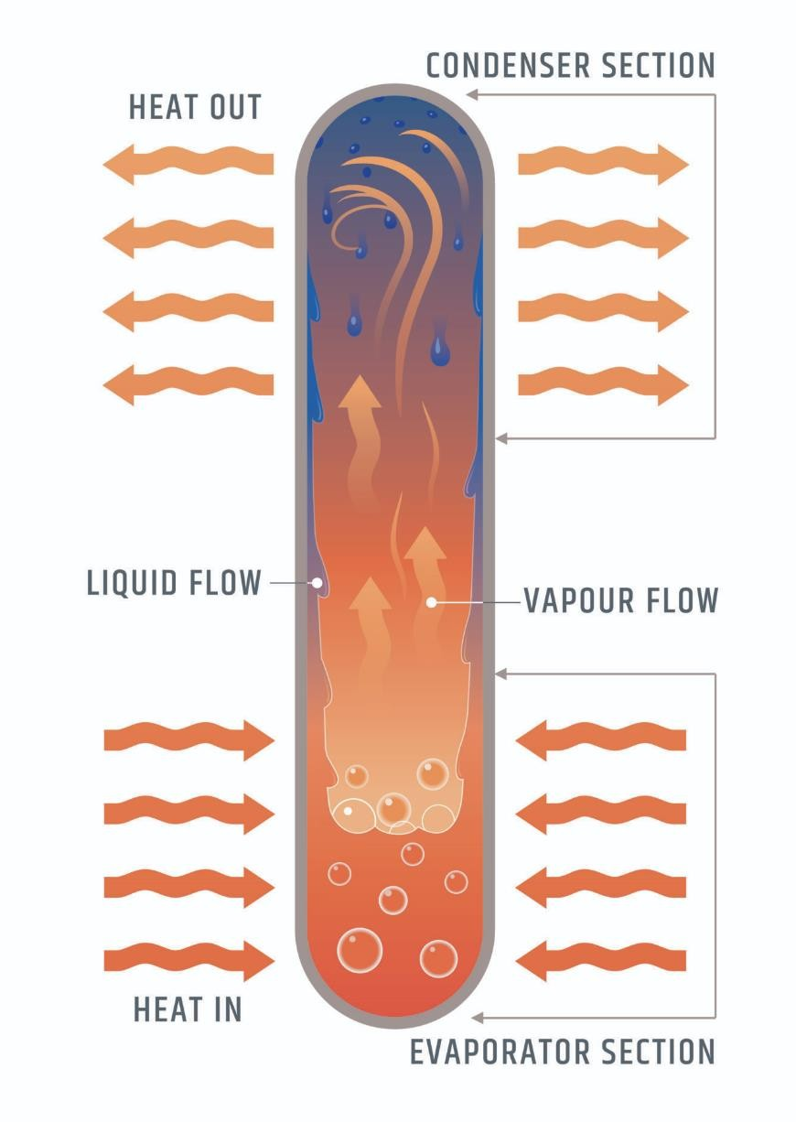


Innovation 7
THE HEAT PIPE
In this device water is used as media to transfer the heat from hot zone to cold zone by evaporation technology.
Since water has high latent heat value this is most suitable media technically and economically.
Continue……

Slide 27
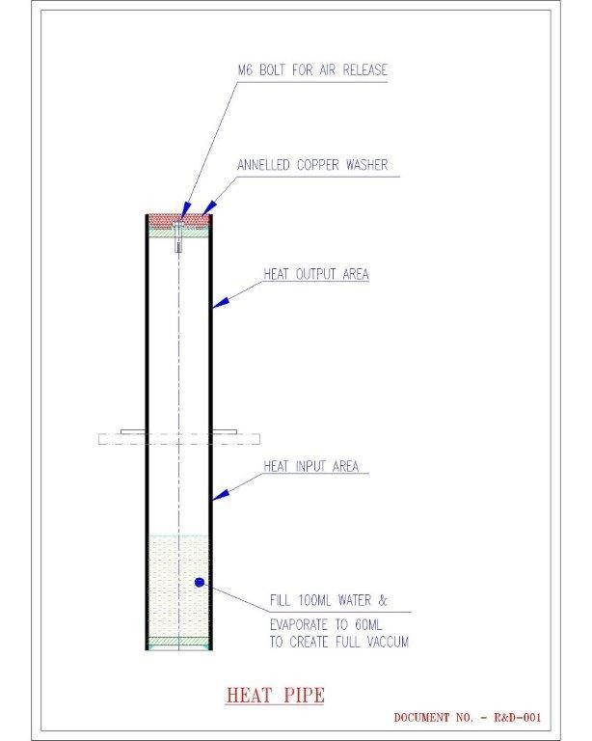

7
THE HEAT PIPE
Since we are maintaining high vacuum in pipe the boiling temperature is very low.

Slide 28

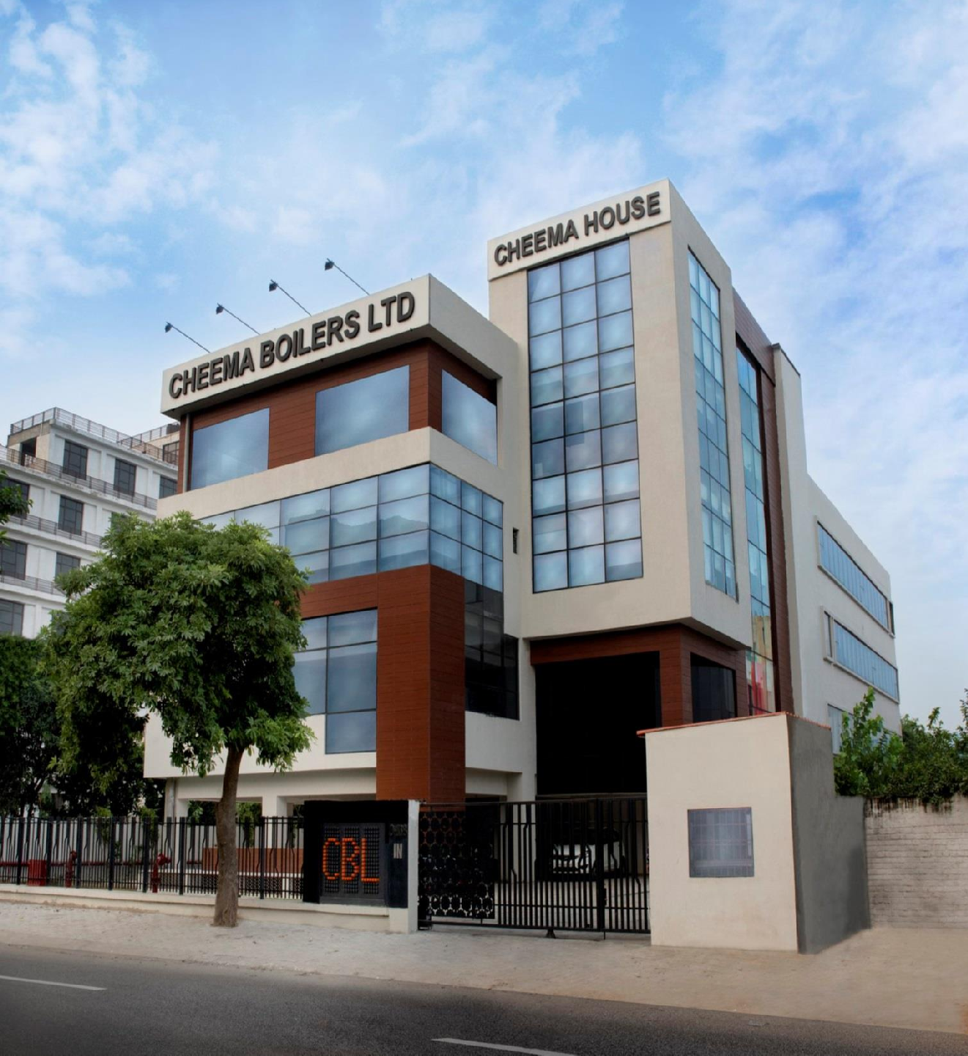
Thank You
Cheema Boilers

